Slide 1
Correlation by Product-Moment Method
Presented By
Munna Sir
B.Ed Depart.
Jamshedpur Cooperative College
B.Ed. 3rd semester
Paper-IX, Unit-V
Statistics

Slide 2
Question: The marks obtained by ten students in two subjects Economics and Maths are given as below, compute coefficient of correlation by product moment method (Karl Pearson's) Method.
STUDENTS NAME | ECONOMICS | MATHS
Anil Kumar | 25 | 10
Shyam Das | 22 | 13
Rite Raj | 28 | 17
Amit Kumar | 30 | 14
Sanjay Das | 30 | 13
Vivek Kumar | 31 | 15
Sameer | 30 | 16
Kishore Khan | 33 | 15
Pratap | 34 | 14
Suman | 37 | 23

Slide 3
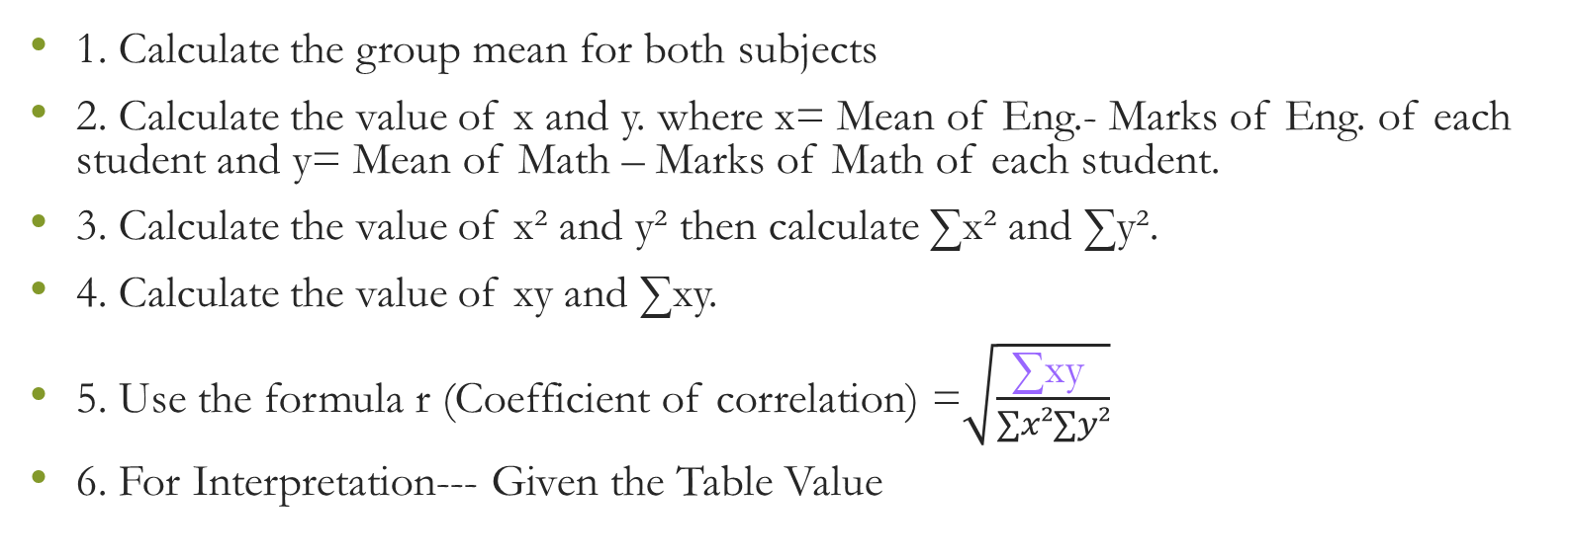
Steps For Solution
1. Calculate the group mean for both subjects
2. Calculate the value of x and y. where x= Mean of Eng.- Marks of Eng. of each student and y= Mean of Math – Marks of Math of each student.
3. Calculate the value of x² and y² then calculate ∑x² and ∑y².
4. Calculate the value of xy and ∑xy.
5. Use the formula r (Coefficient of correlation) =$\sqrt{\frac{\text{∑}\text{xy} }{∑x²∑y²}}$
6. For Interpretation--- Given the Table Value

Slide 4
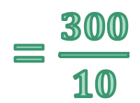
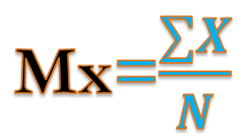
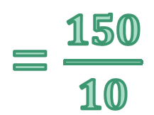

SOLUTION
STUDENT NAMES | ECONOMICS(X) | MATHS(Y)
Anil kumar | 25 | 10
Shyam Das | 22 | 13
Ritu Raj | 28 | 17
Amit Kumar | 30 | 14
Sanjay Das | 30 | 13
Vivek kumar | 31 | 15
Sameer | 30 | 16
Kishor Khan | 33 | 15
Pratap | 34 | 14
Suman | 37 | 23
 | ∑X= 300 | ∑Y= 150
Mx=$\frac{∑X}{N}$
My=$\frac{∑y}{N}$
= $\frac{300}{10}$
= $\frac{150}{10}$
= 30
= 15
Mx—Mean of Eco.
My—Mean of Math.
N- No. of Students

Slide 5
STUDENT NAMES | ECONOMICS(X) | MATHS(Y) | x = X- Mx | y = Y-My
Anil Kumar | 25 | 10 | -5 | -5
Shyam Das | 22 | 13 | -8 | -2
Rite Raj | 28 | 17 | -2 | 2
Amit Kumar | 30 | 14 | 0 | -1
Sanjay Das | 30 | 13 | 0 | -2
Vivek Kumar | 31 | 15 | 1 | 0
Sameer | 30 | 16 | 0 | 1
Kishore Khan | 33 | 15 | 3 | 0
Pratap | 34 | 14 | 4 | -1
Suman | 37 | 23 | 7 | 8
 | ∑X= 300 | ∑Y= 150

Slide 6
STUDENT NAMES | ECONOMICS(X) | MATHS(Y) | x | y | x² | y²
Anil kumar | 25 | 10 | -5 | -5 | 25 | 25
Shyam Das | 22 | 13 | -8 | -2 | 64 | 4
Ritu Raj | 28 | 17 | -2 | 2 | 4 | 4
Amit Kumar | 30 | 14 | 0 | -1 | 0 | 1
Sanjay Das | 30 | 13 | 0 | -2 | 0 | 4
Vivek kumar | 31 | 15 | 1 | 0 | 1 | 0
Sameer | 30 | 16 | 0 | 1 | 0 | 1
Kishor Khan | 33 | 15 | 3 | 0 | 9 | 0
Pratap | 34 | 14 | 4 | -1 | 16 | 1
Suman | 37 | 23 | 7 | 8 | 49 | 64
 | ∑X= 300 | ∑Y= 150 |  |  | ∑x = 168 | ∑y = 104

Slide 7
STUDENT NAMES | ECONOMICS(X) | MATHS(Y) | x | y | x² | y² | xy
Anil kumar | 25 | 10 | -5 | -5 | 25 | 25 | 25
Shyam Das | 22 | 13 | -8 | -2 | 64 | 4 | 16
Ritu Raj | 28 | 17 | -2 | 2 | 4 | 4 | -40
Amit Kumar | 30 | 14 | 0 | -1 | 0 | 1 | 0
Sanjay Das | 30 | 13 | 0 | -2 | 0 | 4 | 0
Vivek kumar | 31 | 15 | 1 | 0 | 1 | 0 | 0
Sameer | 30 | 16 | 0 | 1 | 0 | 1 | 0
Kishor Khan | 33 | 15 | 3 | 0 | 9 | 0 | 0
Pratap | 34 | 14 | 4 | -1 | 16 | 1 | -4
Suman | 37 | 23 | 7 | 8 | 49 | 64 | 56
 | ∑X= 300 | ∑Y= 150 |  |  | ∑x = 168 | ∑y = 104 | ∑xy = 89

Slide 8

Using formula r =$\sqrt{\frac{\text{∑}\text{xy} }{∑x²∑y²}}$
Where, r- coefficient of correlation
r =$\sqrt{\frac{\text{∑}\text{xy} }{∑x²∑y²}}$
r =√("∑xy " /(∑𝑥²∑𝑦²))
=$\sqrt{\frac{\text{89}}{168∗104}}$
=√("89" /(𝟏𝟔𝟖∗𝟏𝟎𝟒))
= $\sqrt{\frac{\text{89}}{17479}}$
= √("89" /𝟏𝟕𝟒𝟕𝟗)
= $\frac{89}{132.18}$
= 𝟖𝟗/(𝟏𝟑𝟐.𝟏𝟖)
= +0.67 Ans

Slide 9
INTERPRETATION
The value of r (+0.67) shows that there is very high positive correlation between the marks obtained by students in Economics and mathematics.
TABLE VALUE
Value of coefficient of correlation | Interpretation
0.00 to ± 0.20 | Negligible
± 0.21 to ± 0.40 | Low
± 0.41 to ± 0.60 | Moderate
± 0.61 to ± 0.80 | High
± 0.81 to ± 0.99 | Very high
± 1.00 | Perfect

Slide 10
THANKS
For Query, contact- 8210255915

