Slide 1
M. Com. Sem 3 Security Analysis and Portfolio Management (Finance Group) Economic Analysis
ASHOK KUMAR RAWANI
Department of Commerce
Jamshedpur Co-operative College
commercejcc@gmail.com

Slide 2
FANDAMENTAL ANALYSIS
Fundamental analysis is a method that attempts to predict the intrinsic value or True value of an investment.
Fundamental Analysis is based on the theory that the market price of an asset tends to move towards its 'real value' or 'intrinsic value’.
In fundamental analysis an investor makes an attempt to study everything that can affect the share price.
Investor can look for information about the economy, industry and the company so that he can find a right security to invest in.
The ultimate aim of doing fundamental analysis is to find a value that an investor can compare with the security’s current price and on basis of his comparison he finally decides whether to buy an underpriced security or to sell an overpriced security.

Slide 3
WHY TO STUDY FUNDAMENTAL ANALYSIS
Before understanding about how to do fundamental analysis one should understand why he should do fundamental analysis. The answer to this question lies in the fact the all of us are rational consumers.
We want more satisfaction for every rupee spent.
Everyone wants to maximize his benefit.
For an example many times when we are at a shop to buy a product we often say to the shopkeeper to tell us the final price of the product at which he is ready to sell as the price told by him earlier are not according to the worth of the product for us.
The same concept applies here. When we buy a share we are offered with various shares from various companies. Here again the question arises that whether the market price of share is a true reflector of its actual worth or not.
Thus fundamental analysis helps hereby doing fundamental analysis one can calculate the intrinsic value of

Slide 4
3 LEVEL OF FUNDAMENTAL ANALYSIS
Thus the factors that affect a company can be broadly classified as:-
Economic factors like rate of growth of the economy, exchange rates etc.
Industry factors like demand and supply in the industry, competitors in the
industry etc.
Company related factors like image of the company and its managers,
profitability etc.
Fundamental Analysis involves the following three analysis
1) Economic Analysis,
2) Industry Analysis,
3) Company Analysis.

Slide 5
ECONOMIC ANALYSIS
Economic Analysis relates to the analysis of the economy.
This related to study about the economy in details and analysis whether economic conditions are favourable for the companies to prosper or not.
Analysts always try to find out whether the economic development is conducive for the growth of the company.
An investor in a security market can give prediction about the future of share price of a company on the basis of the study of forces affecting economic environment of the country.
Take an example of Indian economy, when India is increasing its goodwill and building a positive identity internationally it has led to an increase in investors’ confidence in the economy and in industries.

Slide 6
FACTORS OF ECONOMIC ANALYSIS
For the Economic Analysis, the Macro Economic Factors are studied to know about the condition of an economy or performance of the security market of any country.
Some points to be considered
GDP of the country | Interest rates
Performance of security market | Supply and demand of money
Inflation rate | Government borrowings and loans
Taxation policy and rates | Consumer and goods market
Foreign Direct Investment | Balance of payments etc.
The economy is studied to determine if overall conditions are good for the stock market.

Slide 7
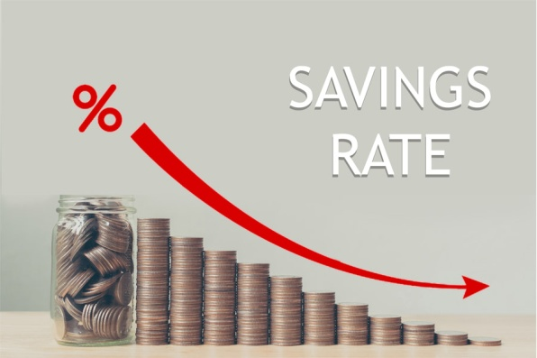
MAJOR TOOLS OF ECONOMIC ANALYSIS
Gross Domestic Product
Fiscal Policy
Monetary Policy
Saving Rate
Trade Deficit
Exchange Rate
Trade Deficit

Slide 8
GROSS DOMESTIC PRODUCT
GDP is the measure of the value of goods and services produced within the domestic boundary of a country.
It is calculated by adding the market prices of all the final goods and services produces in the domestic territory in a year.
The GDP is one the most important indicators used for the measurement of the strength of a country's economy.
In this value added by each firm is measured to determine the health of the economy.
GDP has a greater value and meaning for everyone. But in relation to investors, they are concerned about GDP growth as it determines the growth opportunity for companies to make more profit.
We can understand it in this way also that increase in GDP means increase in the production of goods and services which in turn will result increase in sales of a company and thus increase in profits of the company. This increase in profit will lead to more returns to equity share holders and thus it affects share prices.
For example, if a firm buys wood logs and adds value to it by making a wooden table out of it then in GDP we will take the value of wood logs plus the increase in value of wood logs when they are changed into a table.

Slide 9
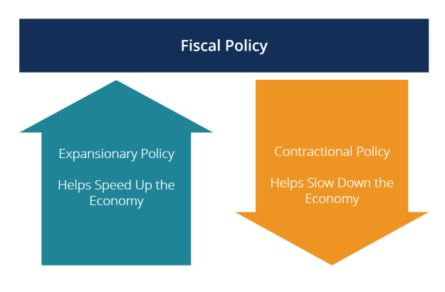
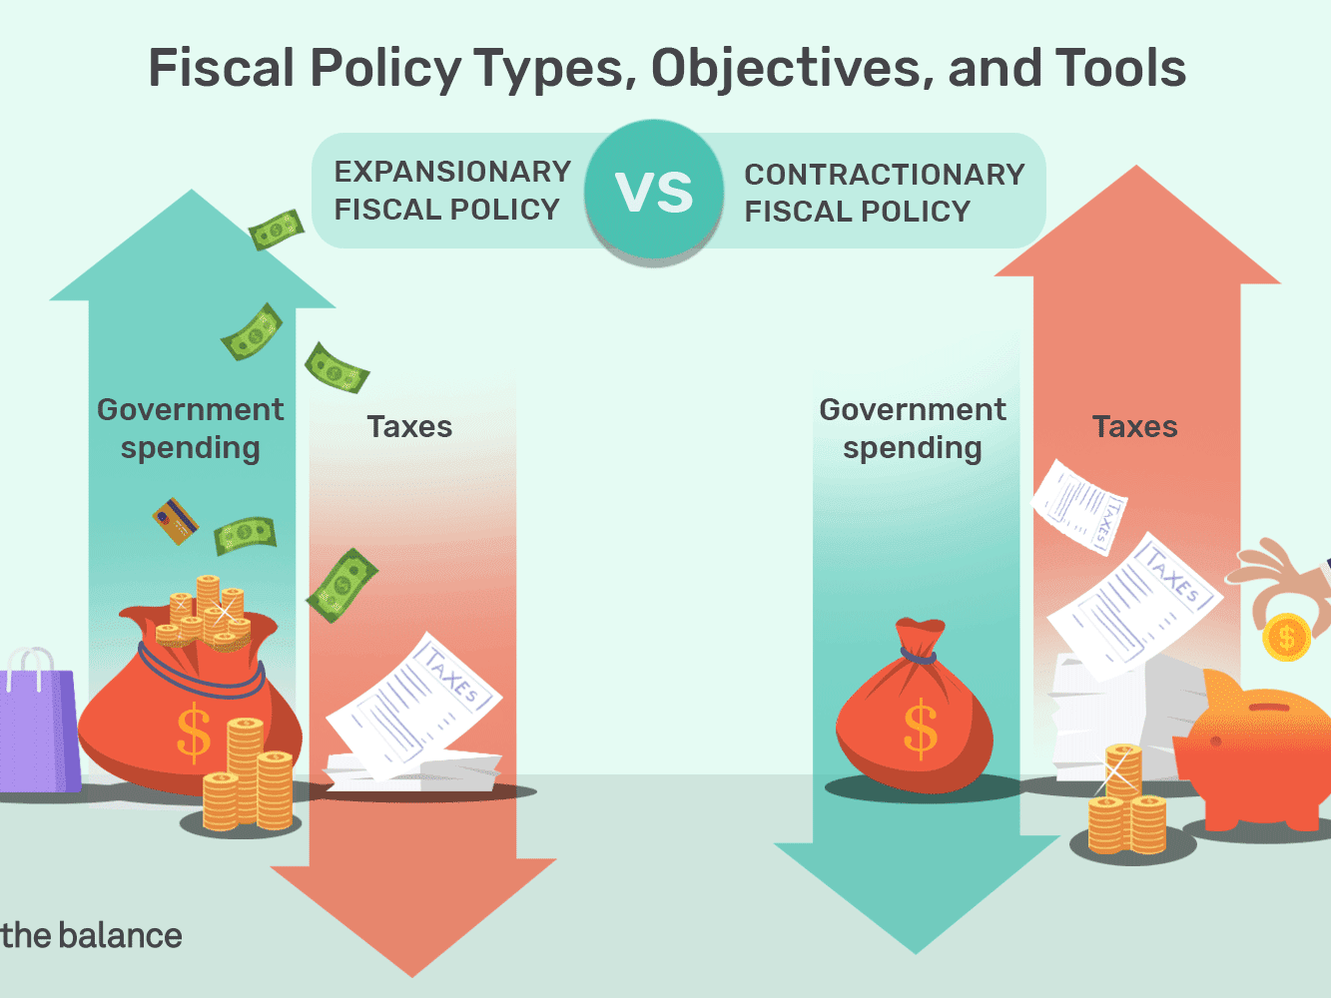
FISCAL POLICY
Whether fiscal policy directly affect stock price or not?
Fiscal policy is the policy through which government adjusts its spending and tax rates to stabilize the economy.
Fiscal policy is in principles based on the thoughts of John Maynard Keynes, where governments could transform economic performance by adjusting tax rates and government spending.
Commonly it has been stated that government spending in the form of subsidies usually reduces the cost of product and thus leaving scope for larger profit of the firm .
The larger profit in turn leads to larger earning per share. This increase in earnings per share will lead to increase in value of share prices.
On the other hand increase in taxes for the company reduces the amount of profit available for share holders. Thus increase in taxes has the effect of reducing the amount of Earning per share and thus leads to fall in share prices of the company.

Slide 10
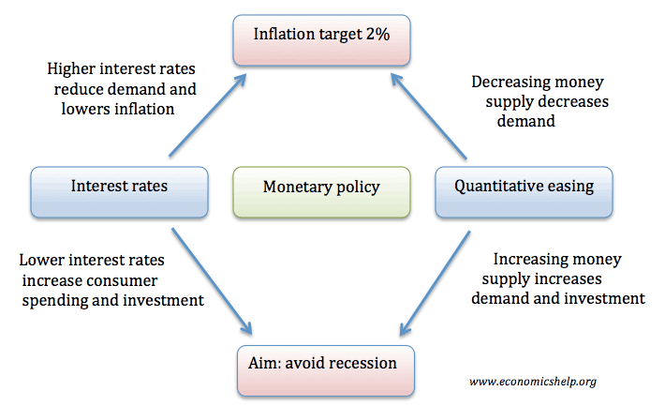
MONETARY POLICY
Monetary Policy is the instrument which it controls the supply of money. za
Monetary policy is deciding about interest rates at which money can be borrowed.
In view of an investor, monetary policy affects share prices if there is variance between the investors’ expectation about the movement of interest rate and actual movement in interest rates.
If RBI raises the interest rate then it will impact the interest rate on debentures and bonds. With increase in interest rates on debentures and bonds there will be change in risk perception of investors and thus they will want higher return on their equity investment.
Thus an increase in interest rate if not accompanied by increase in returned of equity then investors will get inclines towards debentures and bonds rather than equity.
This will affect the demand for equity and thus will lower its prices. Similarly if change in interest rate is as per the expectation of investors then it will not affect equity prices to a larger extent.

Slide 11
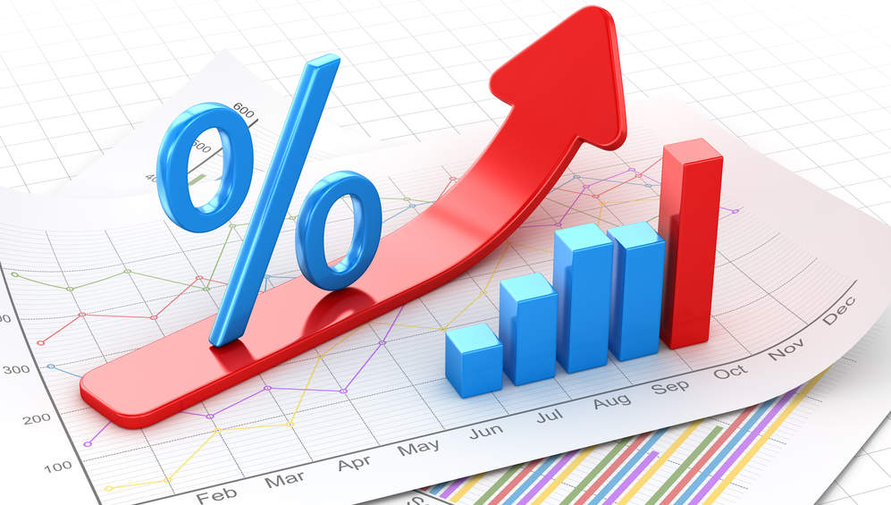
SAVING RATE
Changes in individual saving rate effect the flow of funds into investments.
Increase in interest rate | Decrease in interest rate
This will result in an increase in demand for equity shares. | A lower saving rate means lesser disposal of funds by household into equity market which will reduce the demand for equity.
Thus, share market will be bullish as it has an impact of increase in share prices. | Thus, there will be reduction in share prices and market will be bearish.

Slide 12
TRADE DEFICIT
Trade deficit also impact on share prices.
There are different views regarding trade deficit. Some believe that it is favorable in case of strong expansion. Some says that it is to good in times of recession.
Highlights
Trade deficit occurs when countries imports are more than its export. In other words we can see it that a country is buying more of foreign goods than it is selling to them.
Thus this will impact domestic producers. More imports mean more purchase of foreign goods and less purchase of domestic goods.
This will result in more profitability to foreign companies than domestic producers.
The lesser the profit lesser will the amount of profits available to equity shareholders. Thus it will result in decline in the prices of shares of the domestic company.
On the other hand there will be an increase in the prices of foreign company’s shares

Slide 13
EXCHANGE RATE
Exchange rate is also another factor that affects the trade or net exports between the countries.
This in turn will also affect the trade and business of the companies {having global presence} that is related to any foreign market whether for buying raw material, selling goods or in any other way.
The effect on such companies activities or business will affect that companies profitability and enhance the prices of shares. Thus exchange rate affects share prices.

Slide 14
CONCLUSION
Economic analysis as we have discussed is an indicator of how changes in economic factors will influence a company.
It is a true fact that changes in economic policies and environment will affect the environment in which business is done and companies operate.
Thus a good understanding and eye on economic variables like GDP rate of growth, Monetary policy ,Fiscal Policy, exchange rate, business cycle, imports, exports etc will give a valuable insight into the future of business and company’s performance.
An analysis of GDP and how these components are related to the performance of the industry and companies is also required.
Thus economic analysis helps the investors to get an idea about the direction of change in the capital market as economic analysis deals with forces operating in the overall economy.
Economic analysis has an important role to play in the investment decisions. In fact in this era of globalization when businesses are no more operating in domestic arena only it is very important that one should also study international economic environment and situation to make a good judgment.

